Slide 1


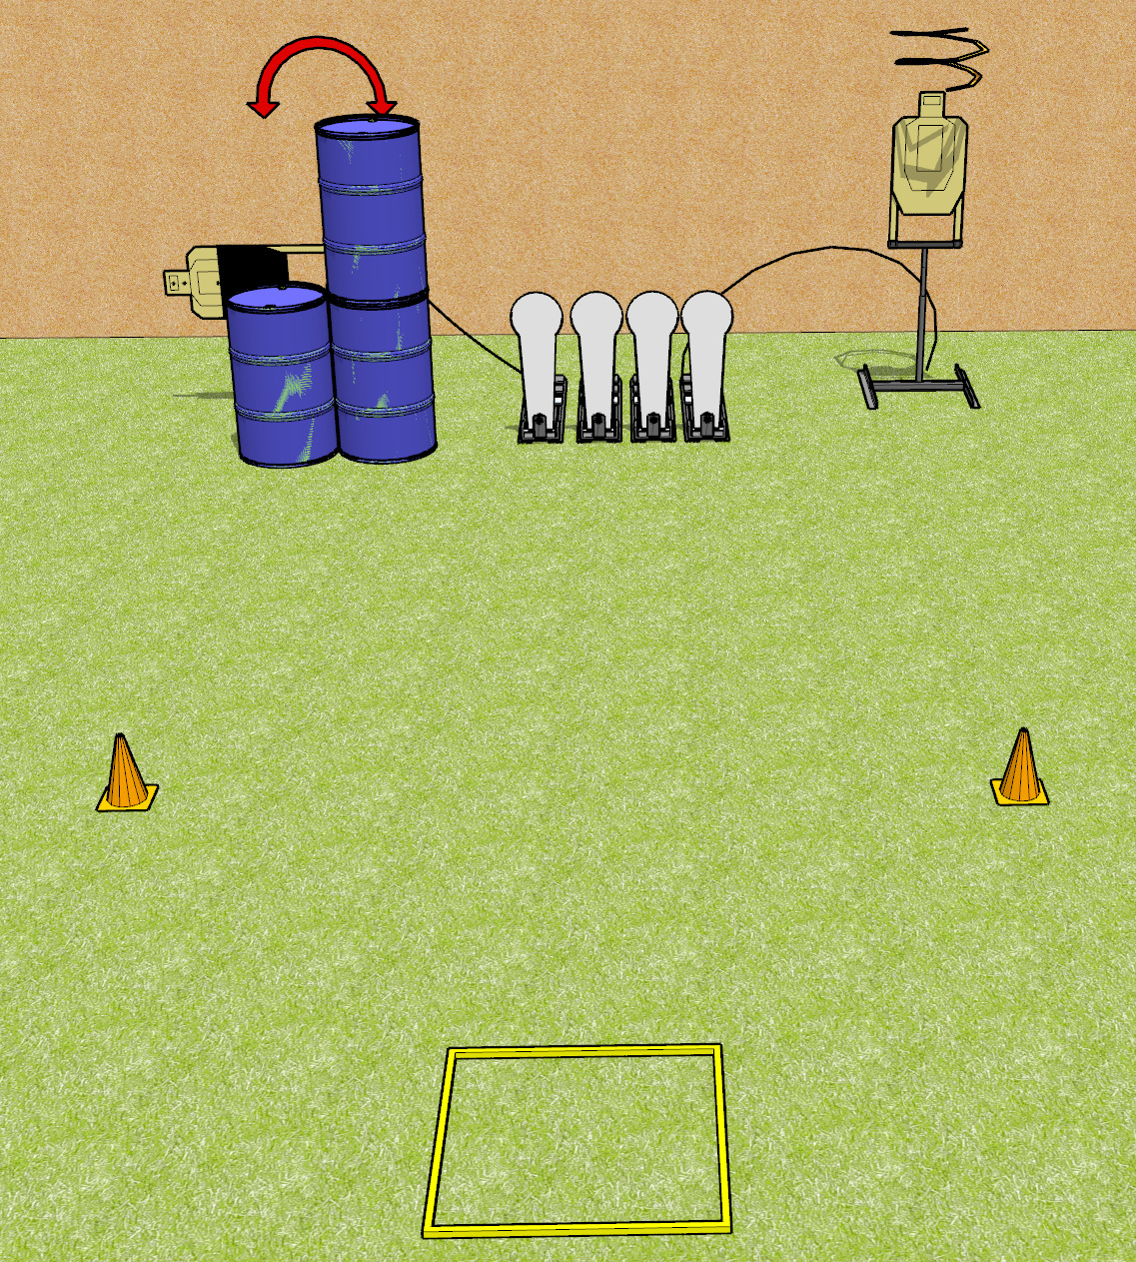
 | Dothan Gun Club – USPSA Match Fast AF Course Designer : Drew Coleman
8 rounds 2 USPSA 4 Colt poppers
Equipment List 1 shooting box Drop turner + activator 1 swinger + activator 1 50% hard cover

Slide 2
Fast AF
Written Stage Briefing
Fast AF is an 8 round, 40 point, Comstock speed shoot. There are 2 USPSA targets and 4 Colt poppers. The best 2 hits on paper will score, and steel must fall to score. The start signal is audible.
The swinger is activated by the leftmost popper and is not disappearing. The drop turner is activated by the rightmost popper and is a disappearing target. Please check the activators prior to walkthrough and set them the same way every time.
Handgun start position is in the shooting box, wrists above shoulders, facing up range. Handgun is loaded and holstered.
PCC start position is in the shooting box, muzzle pointed at either orange cone. Loaded carbine is held with both hands, safety on, shouldered.
On start signal, engage targets as they become available from within the shooting area.

